Slide 1


COMPUTER PRODUCT SUGGESTION

Slide 2
Group 13 - Team Members
Supervisor: Mr. Kiều Trọng Khánh
Phạm Hồng Sang
Huỳnh Thanh Việt
Trần Tân Lên
Hà Chí Danh (Dropped out)

Slide 3
Outline
Scenario problem
Our Solution
Demonstration
Advantages and Disadvantages of current solution
Future Plan
Questions and Answers

Slide 4

Scenario problem
!!!...
???...

Slide 5
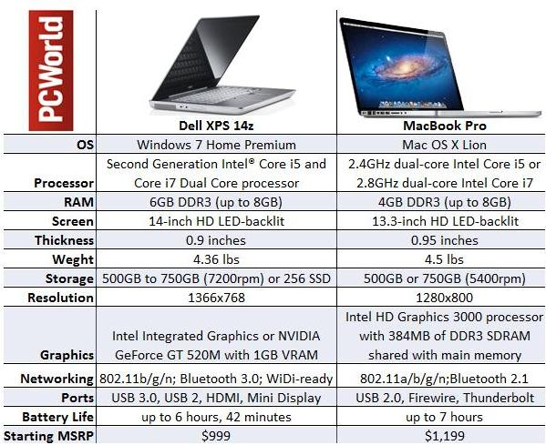
Scenario problem

Slide 6
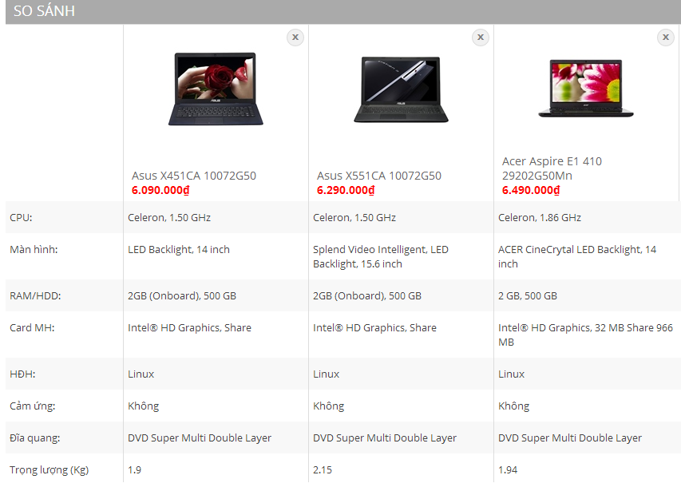

Scenario problem

Slide 7

Scenario problem

Slide 8






Scenario problem
Search
Add to compare
Detail
Detail
Make Decision
Make Decision
Calculate point from another compare hardware website

Slide 9


Scenario problem

Slide 10
Scenario problem
Text Blank all descriptions about laptop are always blanks.
1

Slide 11
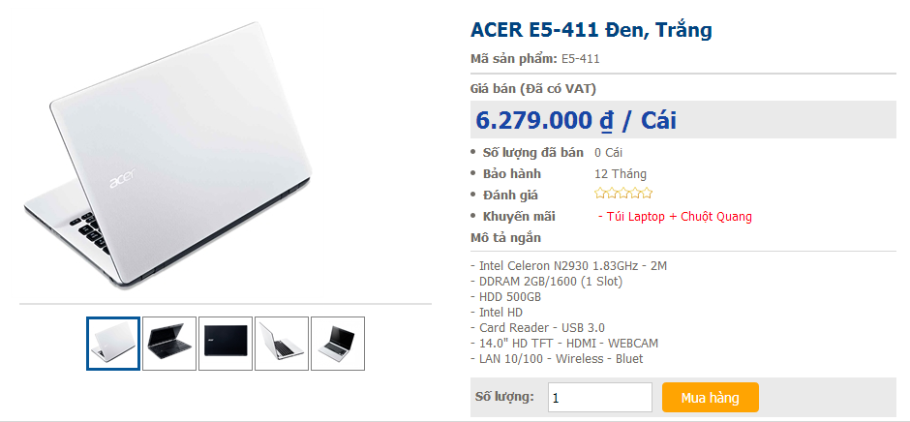
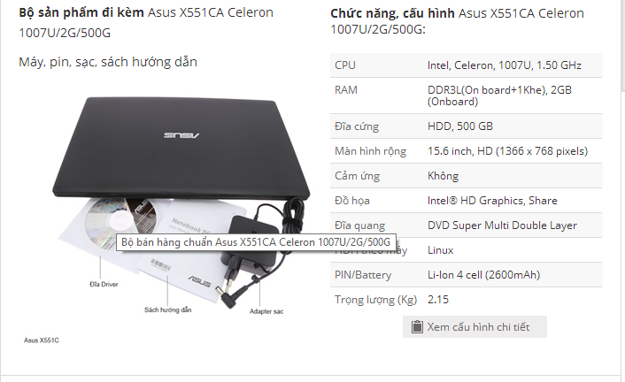
Scenario problem
Limitations We just can focus on 1 website at 1 time for comparing in that website.
2

Slide 12

Scenario problem
Rating system Do not have any rating laptop system in Vietnam.
3

Slide 13
Scenario problem
All of these Disadvantages will make customer to feel confuse when they want to buy laptop but don’t know which one is better than others.
1
2
3

Slide 14
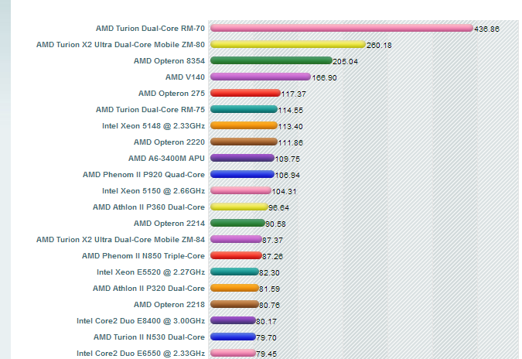



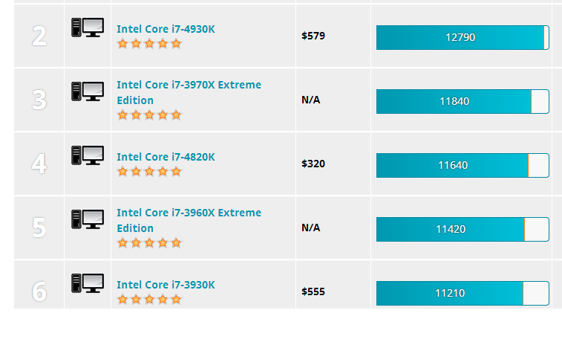
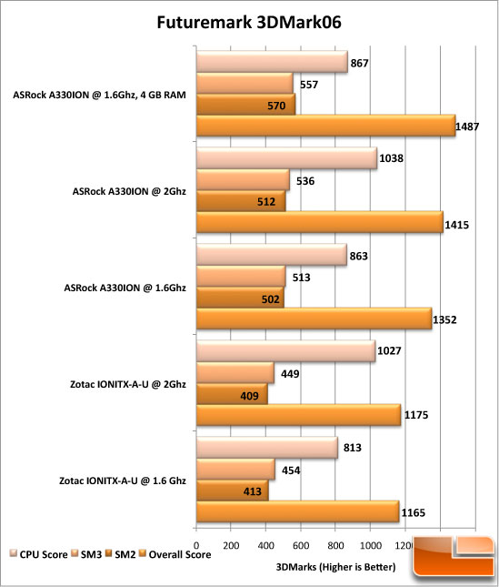

Our idea: collect data
Collect Data

Slide 15





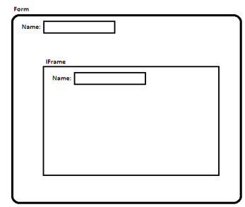
Our idea: collect data by parsing
Take link
Download
Remove Script
Load
Inspect
Display

Slide 16
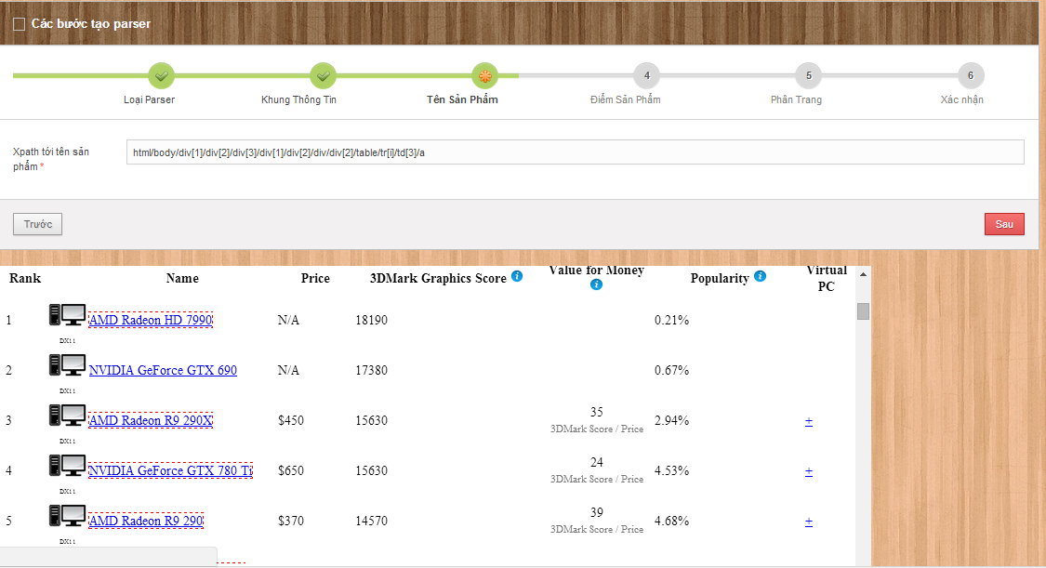
Our idea: collect data by parsing
Step 1-From Clicked Node
Step 2-Get Parent “table” Node
Step 3-Get All Child Node
Step 4-Stop When Meet “HTML Node”Or Meet “ID”
Step 5-Take XPath
Step 6-Get Data

Slide 17
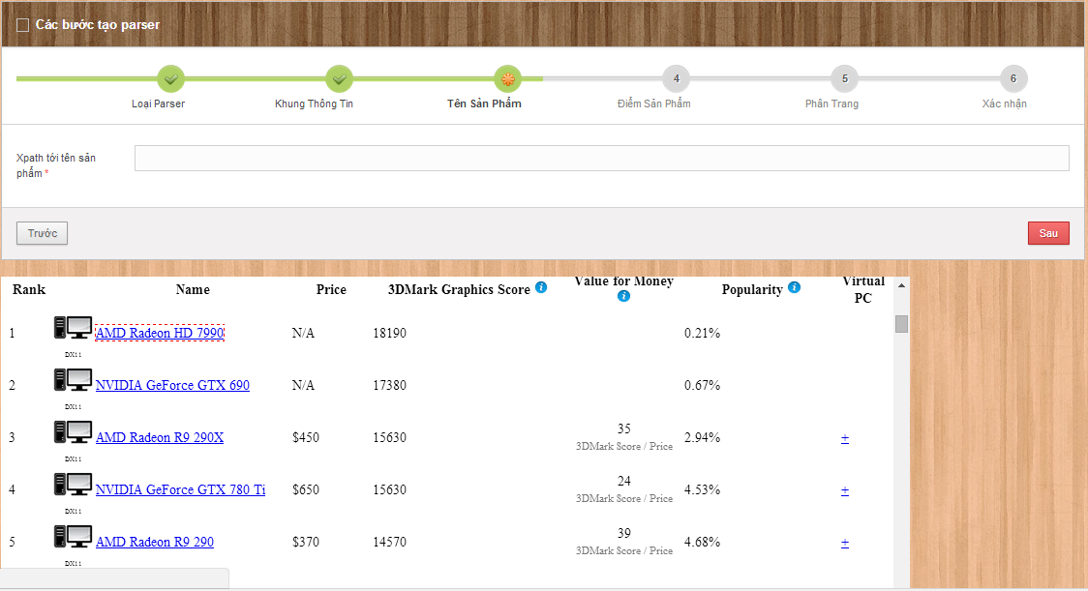
Step: 1&2 GET clicked node and get parent “TABLE” node
1-html/body/div[1]/div[2]/div[3]/div[1]/div[2]/div/div[2]/table/tr[1]/td[3]/a
2-html/body/div[1]/div[2]/div[3]/div[1]/div[2]/div/div[2]/table/tr[2]/td[3]/a
3-html/body/div[1]/div[2]/div[3]/div[1]/div[2]/div/div[2]/table/tr[3]/td[3]/a
4-html/body/div[1]/div[2]/div[3]/div[1]/div[2]/div/div[2]/table/tr[4]/td[3]/a
5-html/body/div[1]/div[2]/div[3]/div[1]/div[2]/div/div[2]/table/tr[5]/td[3]/a
html/body/div[1]/div[2]/div[3]/div[1]/div[2]/div/div[2]/table/tr[i]/td[3]/a

Slide 18


Step 3&4: GET all child node and stop when meet “HTML” NODE, meet “ID”

Slide 19

Step 5&6: Take Xpath and get data
AMD Radeon HD 7990: 18190
NVIDIA GeForce FTX 690: 17380
AMD Radeon R9-290x : 15630
NVIDIA GeForce GTX 780: 15630
AMD Radeon R9 290: 14570
Product Name Xpath
Product Point Xpath

Slide 20




Our idea: build data system
Build Data System

Slide 21





Our idea: build data system
New Laptop
Data Object
Is New
False
True

Slide 22

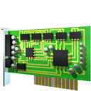






Our idea: build data system
Compare (80%<a<100%)
Compare (a =100%)
True
False
Gross
Split
True
False

Slide 23

Our idea: publish to user
Go Online

Slide 24


Our idea:PROCESS DATA

Slide 25



Problem solution: example problem
Give 2 laptops, find out the best of them.
HP PAVILION 14 N237TU
ACER ASPIRE E1 470G

Slide 26

Problem solution
Determine 5 types of laptop’s hardware which are the most customer will be interested in when choosing a laptop.
Chipset (CPU)
Graphic card (VGA)
Memory (RAM)
Hard disk (HDD)
Screen solution
http://bit.ly/cps-survey-summary

Slide 27
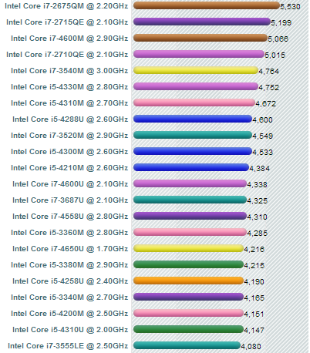

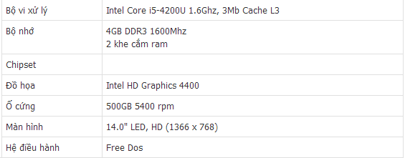



Problem solution: collect data
Laptop’s Hardwares
Laptops
cpubenchmark.net
viettelstore.vn

Slide 28


Problem solution: reduce score
 | HP PAVILION 14 N237TU | ACER ASPIRE E1 470G
Chipset (CPU) | 3293 | 2294
Graphic card (VGA) | 600 | 1070
Memory (RAM) | 4 | 2
Hard disk (HDD) | 500 | 500
Screen solution | 14 | 14

Slide 29
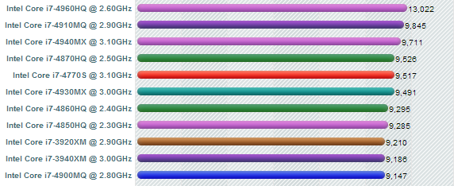
Problem solution: reduce score
➢ Reduce hardware’s score on the scale from 1 to 100
➢ Define:
x = Highest hardware’s score.

Slide 30
Problem solution: reduce score
➢ Reduce hardware’s score on the scale from 1 to 100
➢ Define:
x = Highest hardware’s score.
y =
Hardware’s score which will reduce.
3293

Slide 31
Problem solution: reduce score
➢ Reduce hardware’s score on the scale from 1 to 100
➢ Define:
x = Highest hardware’s score.
y =
Hardware’s score which will reduce.
h = Hardware’s score on the scale from 1 to 100
☞

Slide 32

Problem solution: reduce score
 | HP PAVILION 14 N237TU | ACER ASPIRE E1 470G
Chipset (CPU) | Intel Core i5-4200U | Intel Core i3-3217U
Score in the database | 3293 | 2294
Highest score in the database | 13200 | 13200
Score on the scale from 1 to 100
Chipset’s score

Slide 33
Problem solution: reduce score
 | HP PAVILION 14 N237TU | ACER ASPIRE E1 470G
Video card (VGA) | Intel HD Graphic 4400 Mobile | NVIDIA GeForce GT 720M
Score in the database | 600 | 1070
Highest score in the database | 18190 | 18190
Score on the scale from 1 to 100
Video card’s score

Slide 34
Problem solution: reduce score
 | HP PAVILION 14 N237TU | ACER ASPIRE E1 470G
Chipset (CPU) | 24.95 | 17.38
Graphic card (VGA) | 3.30 | 5.88
Memory (RAM) | 25 | 12.5
Hard disk (HDD) | 12.5 | 12.5
Screen solution | 80.92 | 80.92
Hardware’s score

Slide 35
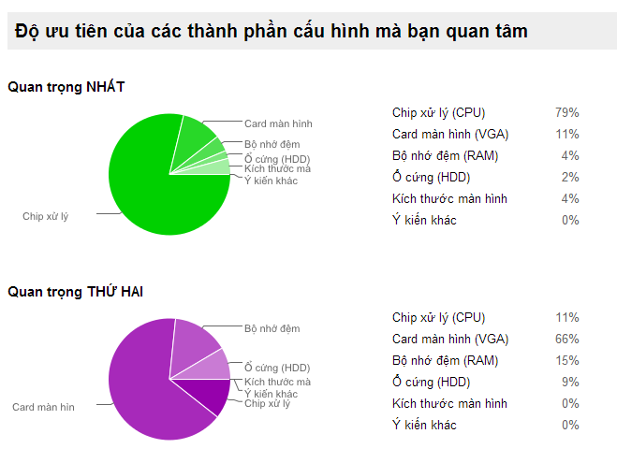
Problem solution: priority coefficient
http://bit.ly/cps-survey-summary

Slide 36
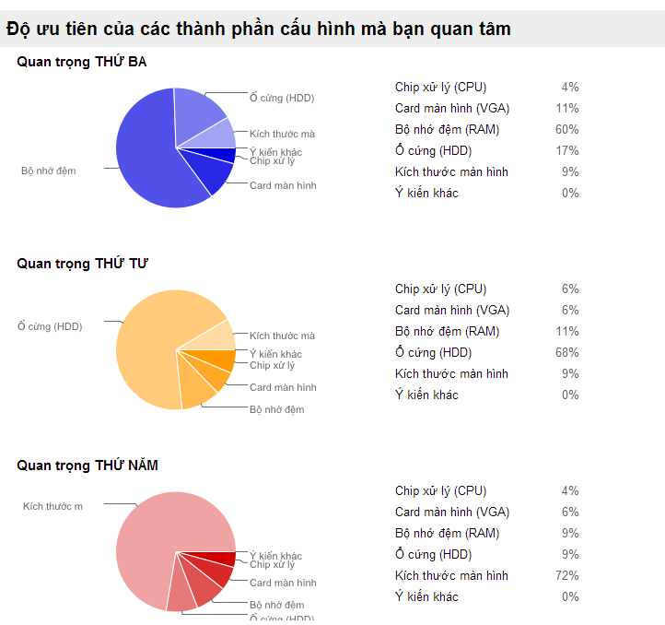
Problem solution: priority coefficient
http://bit.ly/cps-survey-summary

Slide 37
Problem solution: calculate product’s score
Hardware’s name | Score
Chipset (CPU) | c
Graphic card (VGA) | v
Memory (RAM) | r
Hard disk (HDD) | h
Screen solution | s
☞

Slide 38
Problem solution: calculate product’s score
HP PAVILION 14 N237TU
ACER ASPIRE E1 470G

Slide 39
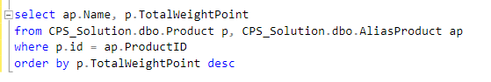
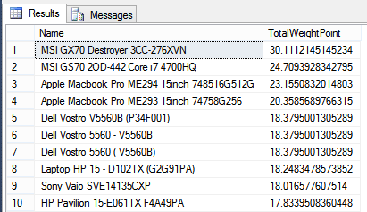
Problem solution: reduce score

Slide 40
Problem solution: reduce score
 | HP PAVILION 14 N237TU | ACER ASPIRE E1 470G
Product’s score | 12.86 | 11.26
Highest score in the database | 30.11 | 30.11

Slide 41
Problem solution: reduce score
➢ Reduce hardware’s score on the scale from 1 to 100
➢ Define:
P = Highest product’s score
p =
Product’s score
p’ = Product’s score on the scale from 1 to 100
☞

Slide 42
Problem solution: reduce score
 | HP PAVILION 14 N237TU | ACER ASPIRE E1 470G
Product’s score | 12.86 | 11.26
Highest score in the database | 30.11 | 30.11
Score on the scale from 1 to 100
Product’s score

Slide 43
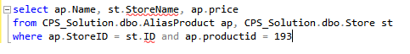
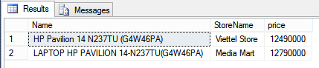
Problem solution: calculate price/score
➢ A product will many price tags from many store
Min Price
Max Price

Slide 44
Problem solution: calculate price/score
➢ A product will many price tags from many store
➢ Define:
Pmin/max = Min/Max product’s price
S =
Product’s score
Rmin/max = Min/Max price for each score
☞

Slide 45
Problem solution: calculate price/score
 | HP PAVILION 14 N237TU | ACER ASPIRE E1 470G
Product’s min price (VNĐ) | 12.490.000 | 8.990.000
Product’s max price (VNĐ) | 12.790.000 | 8.990.000
Product’s score | 12.86 | 11.26
Min Price for each score (VNĐ)
Max Price for each score (VNĐ)
Price for each score

Slide 46

Problem solution: compare
Product’s score on the scale from 1 to 100
Min/Max price of each product’s score

Slide 47
Features
Search
Smart
Compare
Recommend
Product
Suggestion
Import Excel
Get data from web
Training System

Slide 48

demonstration

Slide 49



Story board
 | Guest
 | Member
 | Staff

Slide 50



Demo scenario: guest
Search product
Add to cart
View compare

Slide 51





Demo scenario: member
Search product by Price
View Compare
Search Not Found
View Details
Recommend

Slide 52

Demo scenario: staff
Train machine
Get data from web

Slide 53
Advantages AND Disadvantages
Advantages
Suggestion
Training System
Disadvantages
Staff spend time for training
Not support mobile version
Many Resources
Smart Compare
Not provide Payment Method
Staff must have knowledge about hardware

Slide 54


Future plan
Optimize algorithm
Build mobile application

Slide 55
Q&A

Slide 56
Thank You !

